Slide 1
Machine Learning. Data Science.
Jamie Dixon
28 Nov 2023
Notes:
TDD? ADD? HDD?

Slide 2
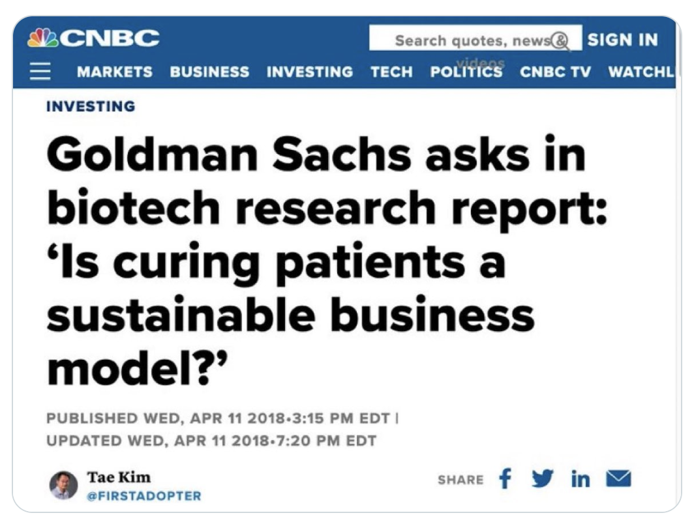
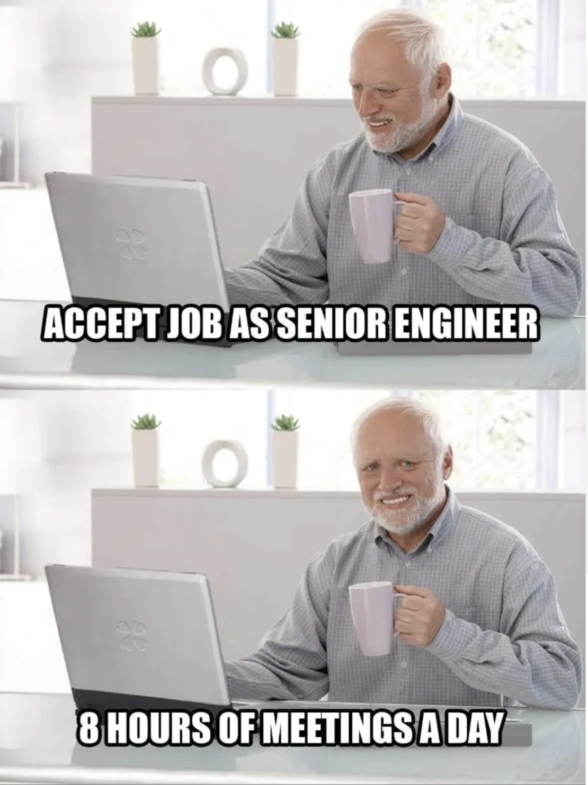
About Me
Writing Code since 1985. Getting paid to do it since 1995.
MPH from Michigan.
Hats |> Software Eng, SE Team Lead, App Architect, NLP Tech Lead, Data Scientist, CTO
Failed PhD applicant. Layer Lab Volunteer. Not giving up.
Interested in preventing/curing T1D.

Slide 3
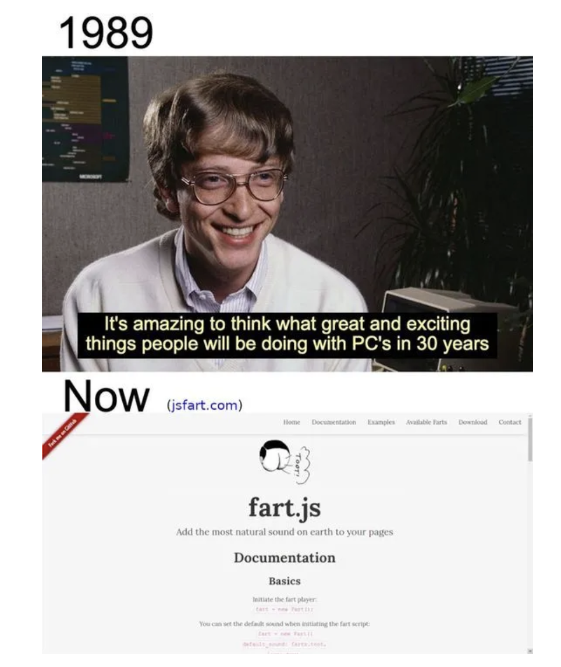
About You
Poll
You are the elite
You are lucky
Code Won. What does that mean?
Your ability to be successful is based on:
Ability to use computers
Ability to use other people
You have to wear many hats: PM, BA, AA, IE, SWE, S&M

Slide 4
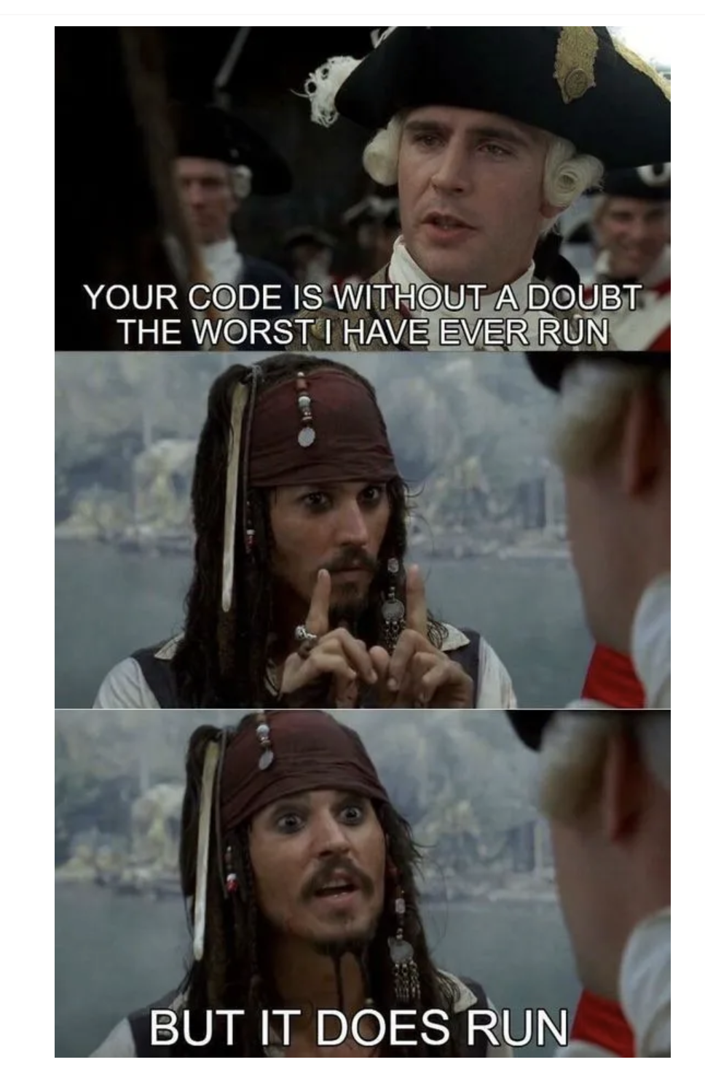
Agenda
Software Engineering Concepts
Domain Ubiquitous Language
Function Argument Validation
Pure and Impure Functions
Immutability
(Refactoring)
Software Architecture Concept
Data & Functions (and all functions are a map)
Two Track Architecture
Data Science Architecture Concepts
Safe Room
Dependency Injection
Inside Out: Functions 1st, Data Last

Slide 5
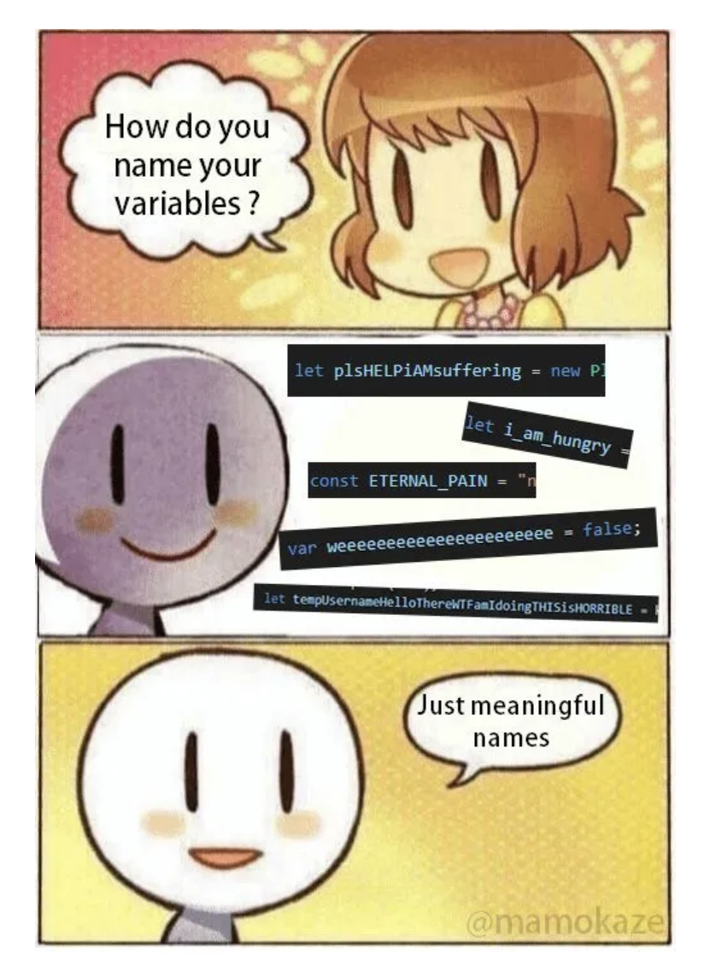
Concept: Domain Ubiquitous Language
In your entire codebase, 1 word means 1 thing only. And always use it.
The industry has already taken certain words
“index”, “list”, “map”
No such thing as a “file”: “file_path” and “file_contents”
Your domain has already taken certain words
“Spectra”, “Database”
Notes:
How much do you need to know as the programmer? Acnoyms? Mfa = magnetic field align

Slide 6
Example
Spectra/Spectrum
weight/charge

Slide 7
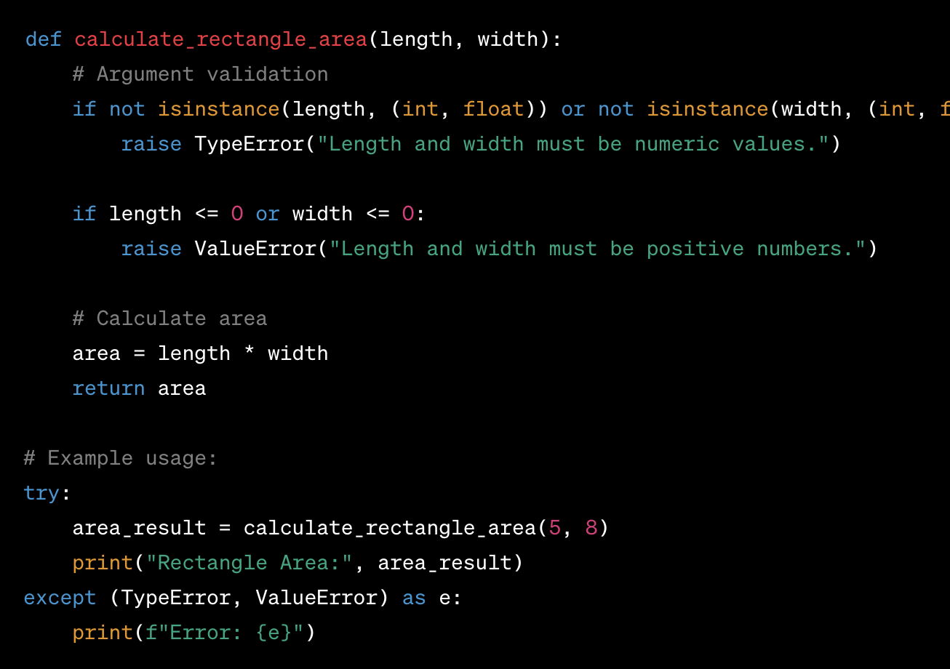
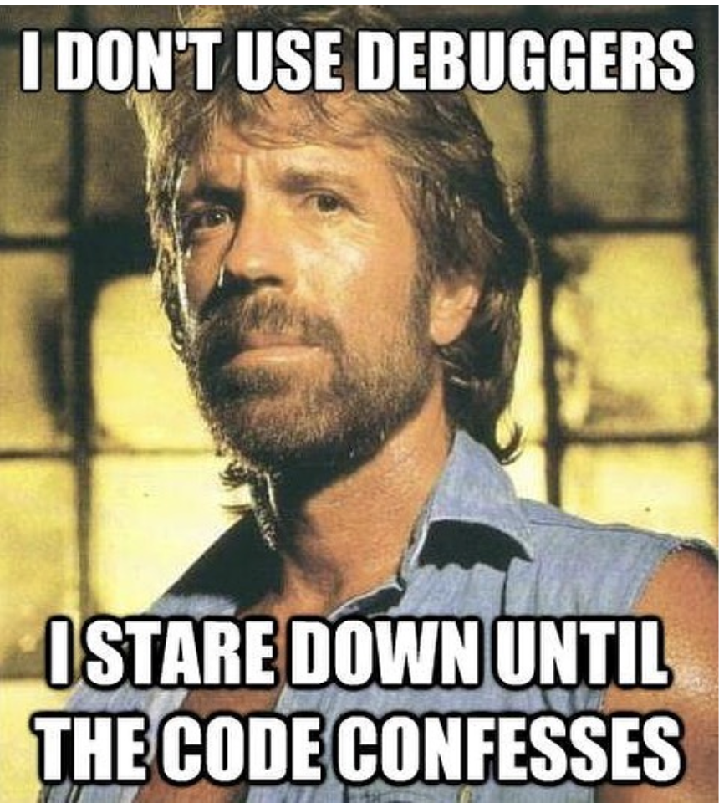
SE Concept: Function Argument Validation

Slide 8
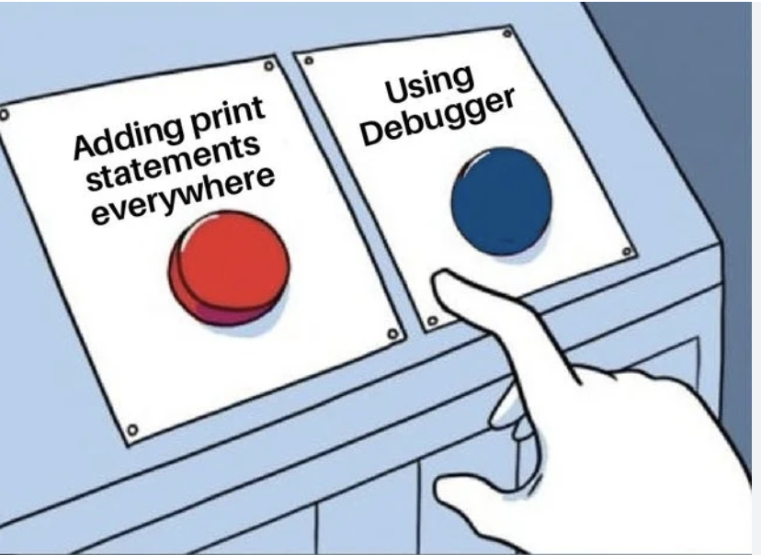
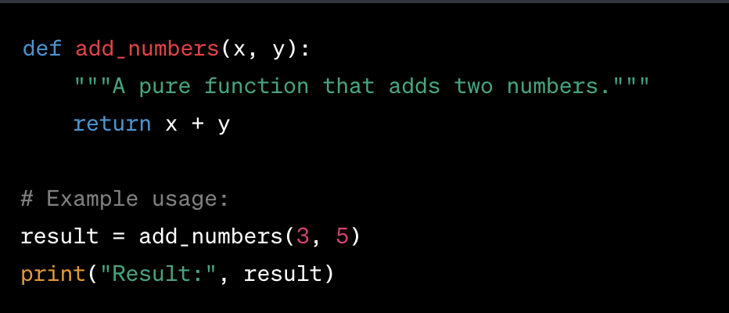
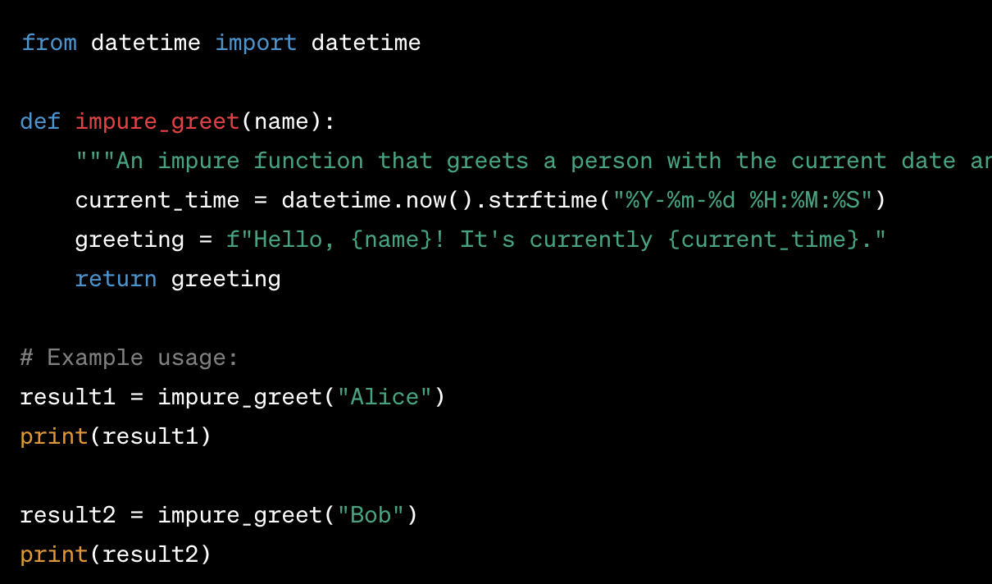
SE Concept: Pure and Impure Functions
Impure: Global Variables, Disk I/O, Database writes, CPU bound processes, date/time, etc...

Slide 9
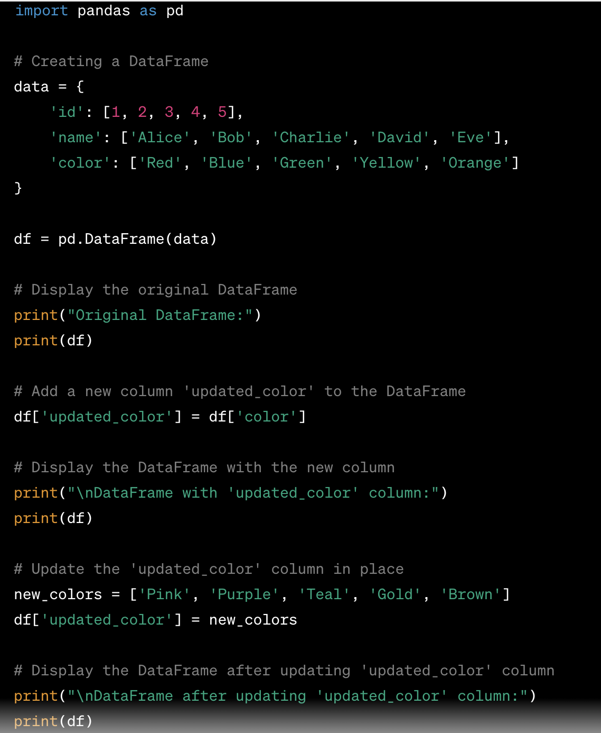
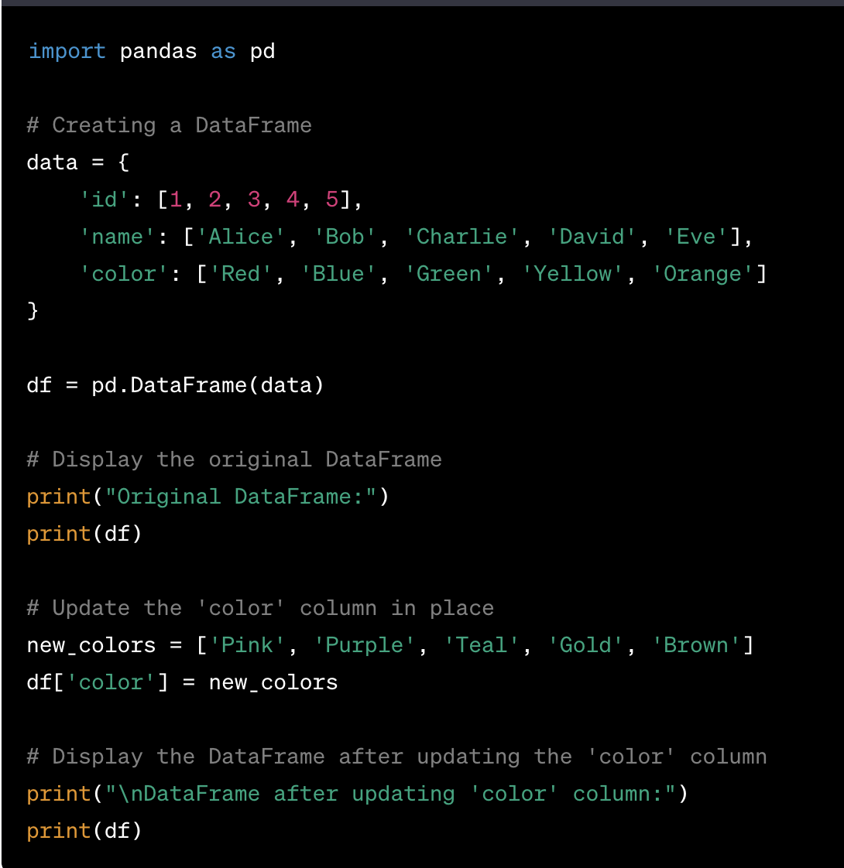
SE Concept: Immutability

Slide 10
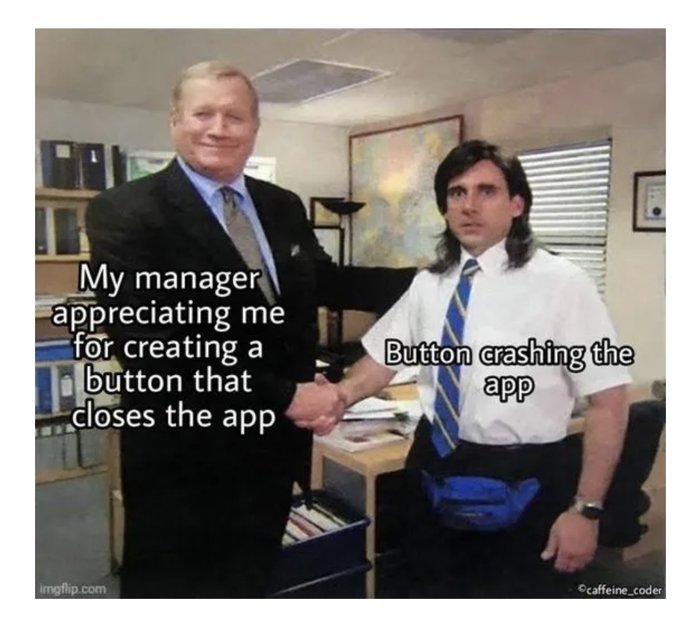
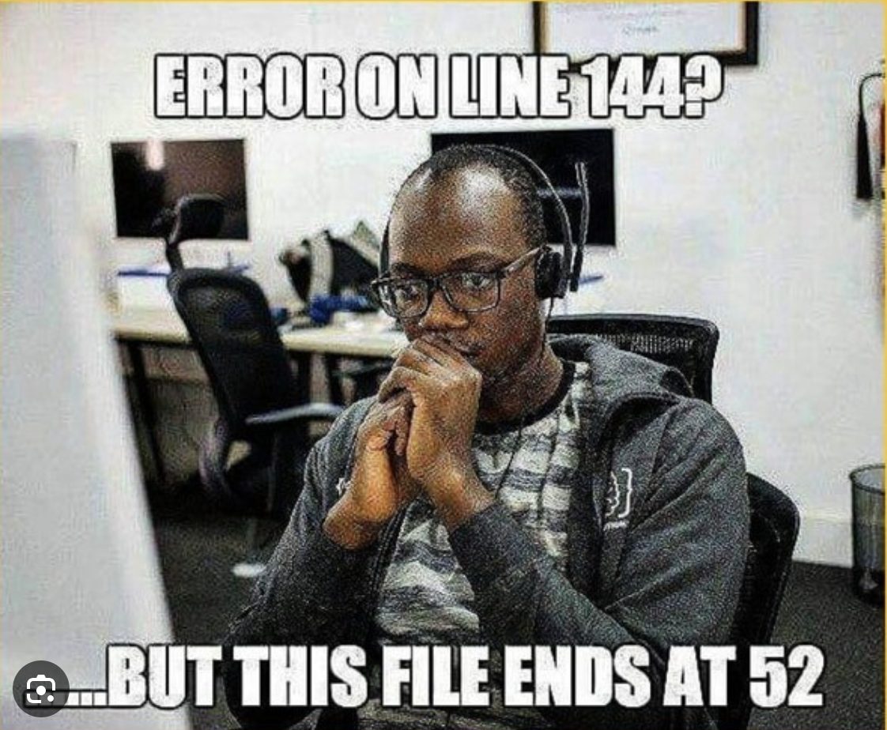
SE Concept: Refactoring
VS Code Demo
Notes:
Example 1 – date time. Example two: rename get data

Slide 11
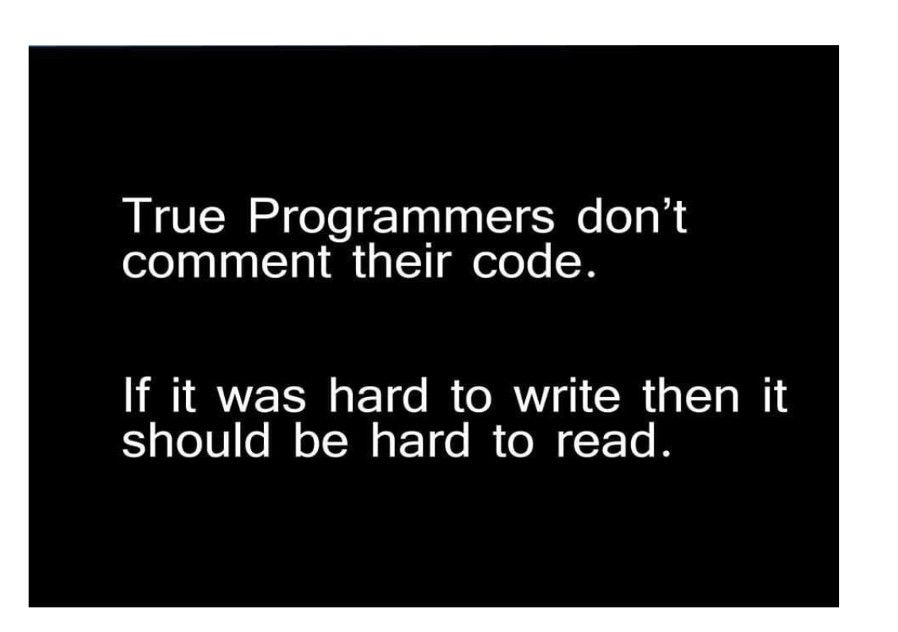
SA Concept: Data and Function
VS Code Demo
Notes:
Example: Data are nouns, Functions are verbs

Slide 12
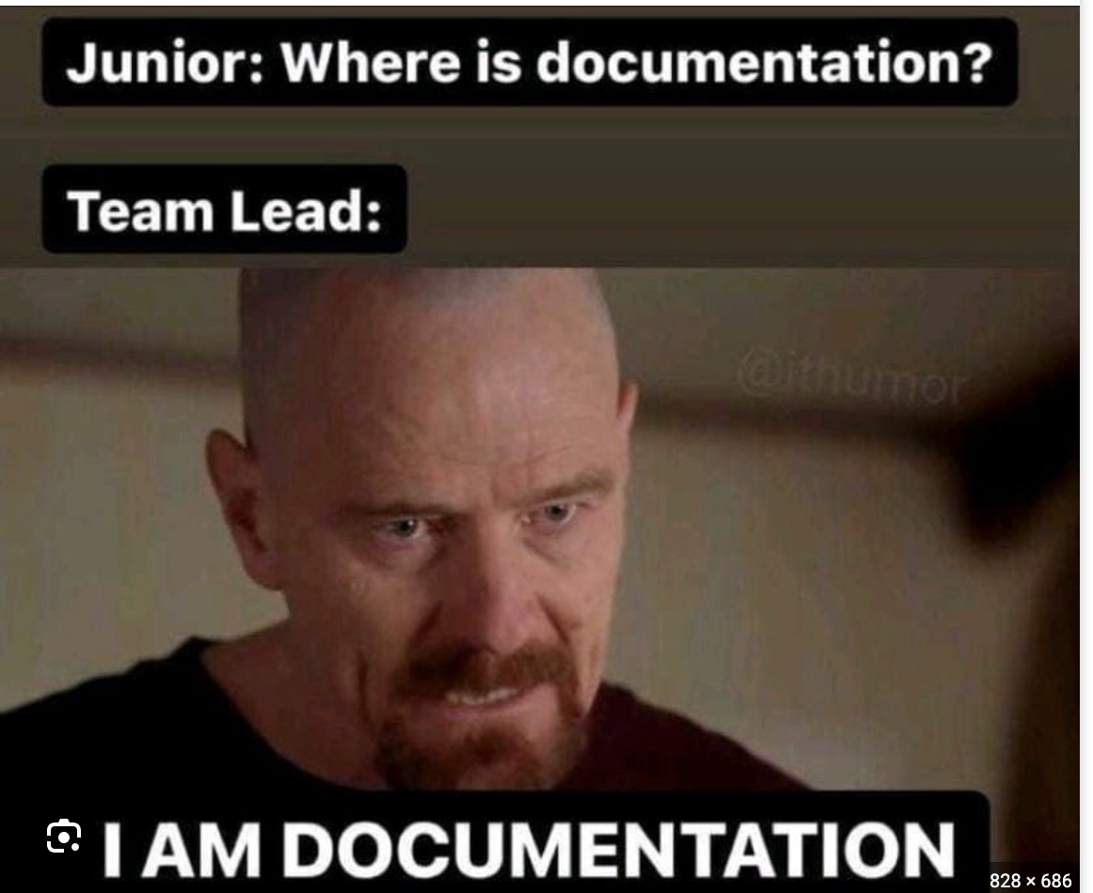
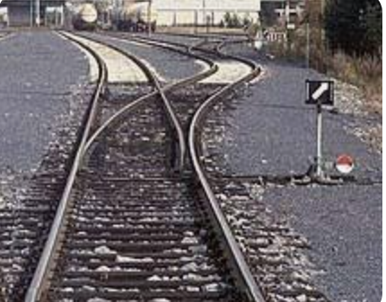
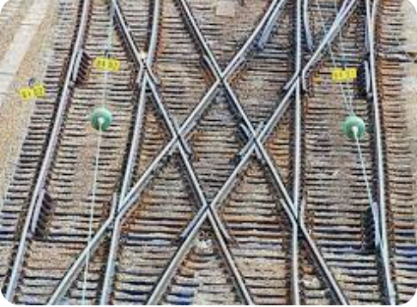
SA Concept: Two Track Architecture

Slide 13
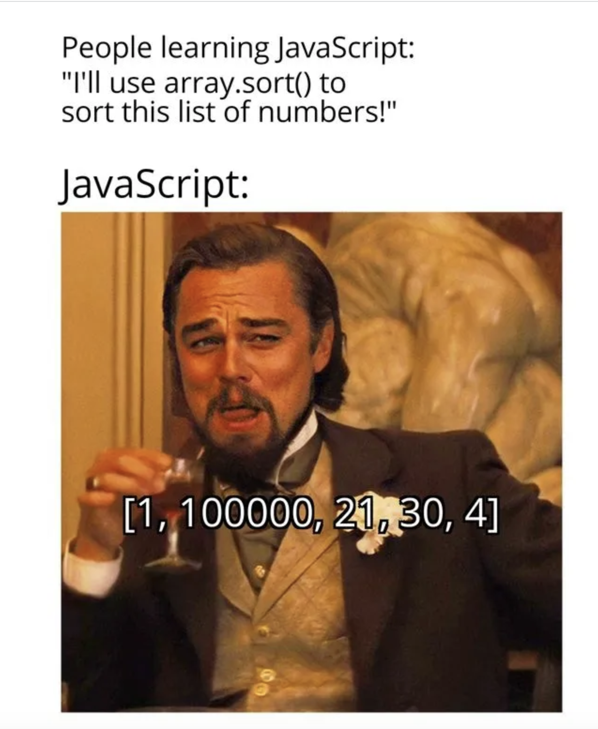
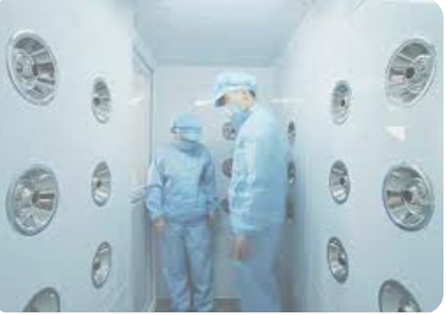
DSA Concept: Safe Room
Notes:
Argument validation

Slide 14
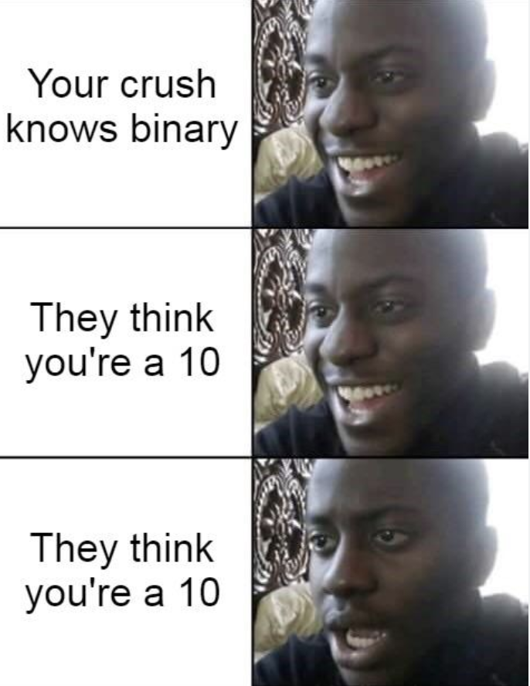
DSA Concept: Dependency Injection
VS Code Demo

Slide 15
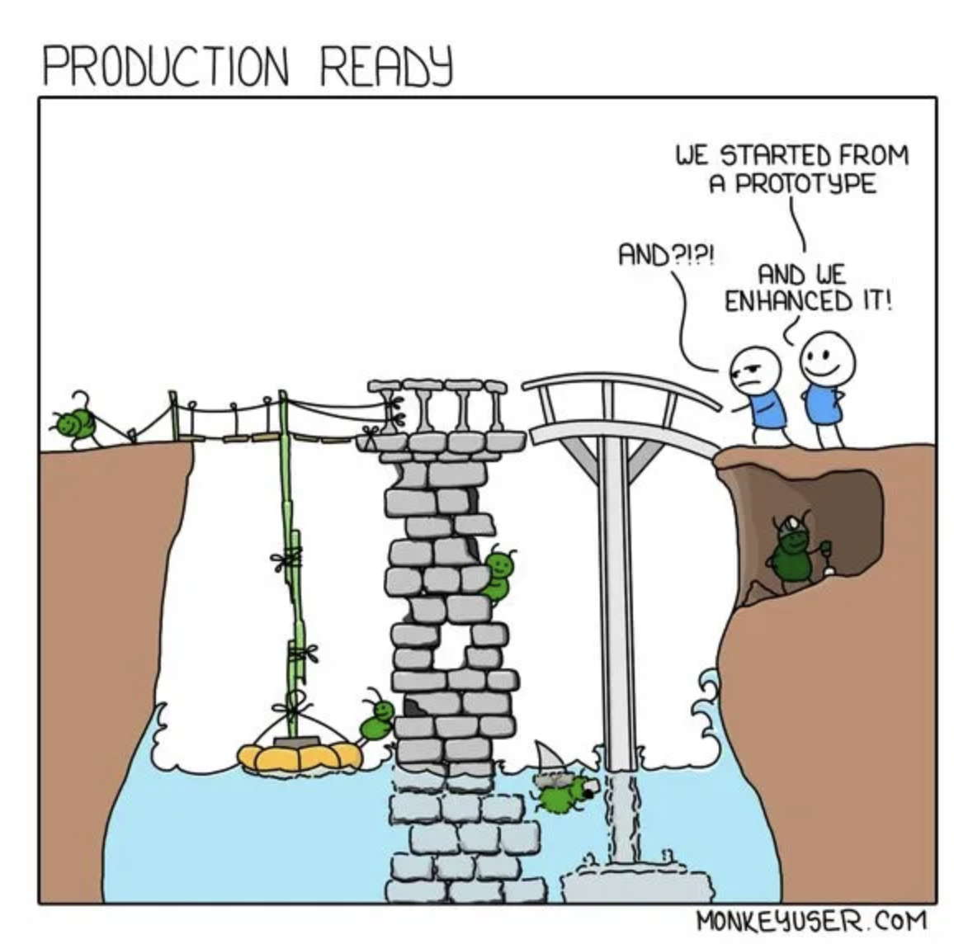
DSA Concept: Functions First, Data Last
Shape Of The Answer First
Inside the for loop first

Slide 16
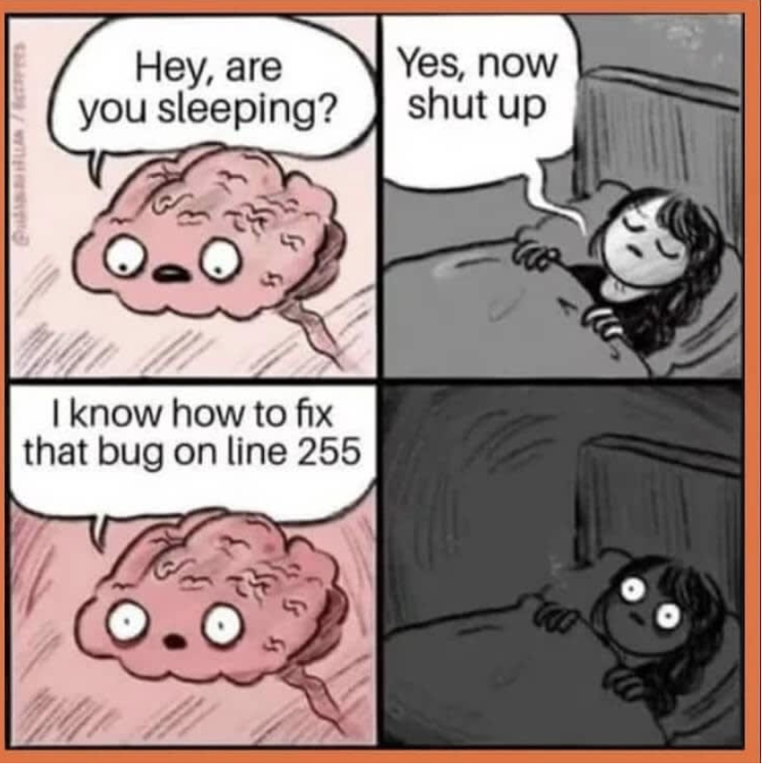
Wrap Up
Questions/Comments/Concerns

